Slide 1
bag hunter
Farfetch.com
Deep Learning Bags Brand Prediction App

Slide 2
Intro

Slide 3

WHAT ARE WE WORKING ON
Needs
Question
Goal
Online retailers Mass products Time Consuming
Can it identify the bag’s brand by image?
Deep Learning, Cloud Computing, Data Pipeline
Images Classification app

Slide 4
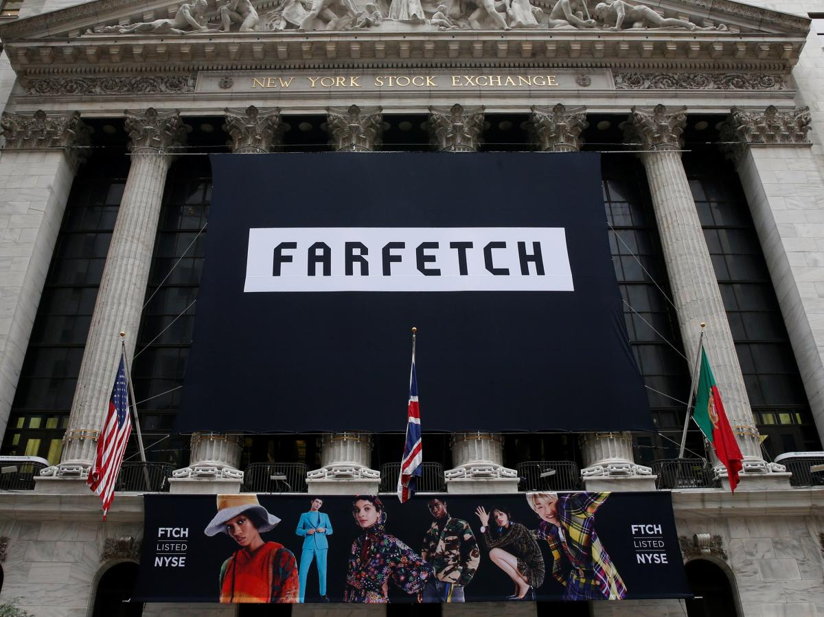
FARFETCH
UK luxury retail company
Founded in 2007
Global platform
Sells over 700 boutiques brands

Slide 5
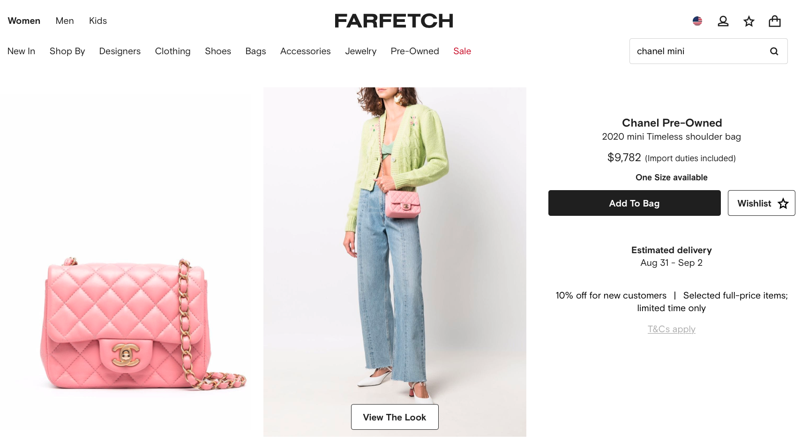
FARFETCH.com

Slide 6
DATA

Slide 7
Data Acquisition
API Json
MongoDB
Bag Section
Data size 400,000 (all products)
↓
21,000 (all 669 bag brands)
↓
1,670 (Top 5 bag brands)
Notes:
(CLICK) For data size, the original data size was 400,000 products. This includes all products on the site of that 21,000 were bags from all bag brands.
And I chose the top five bag brands and this gave me 1670 bags to work with

Slide 8
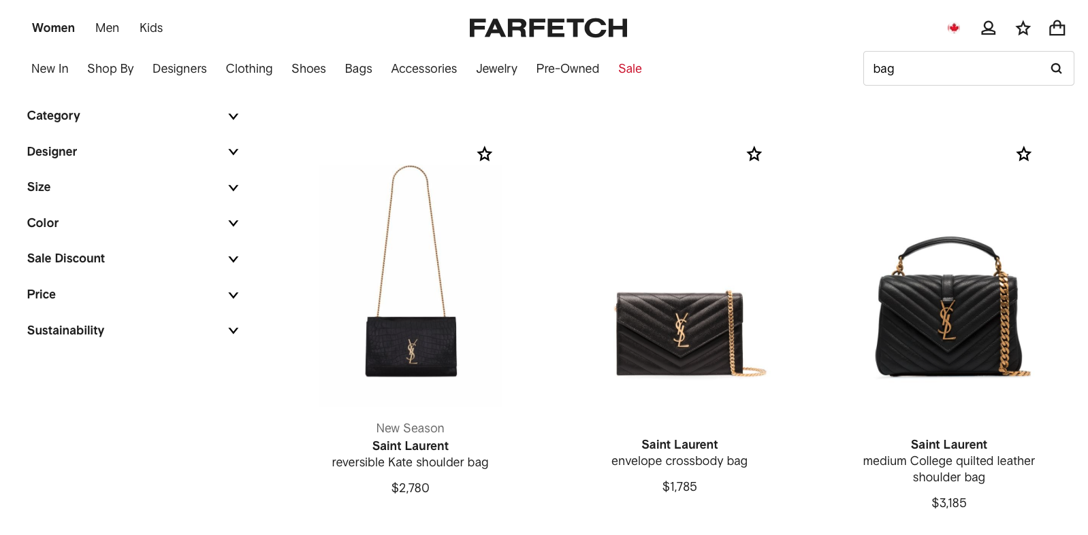
YSL
API – webscrap
Bag sections : BAGS REAL PICTURES

Slide 9
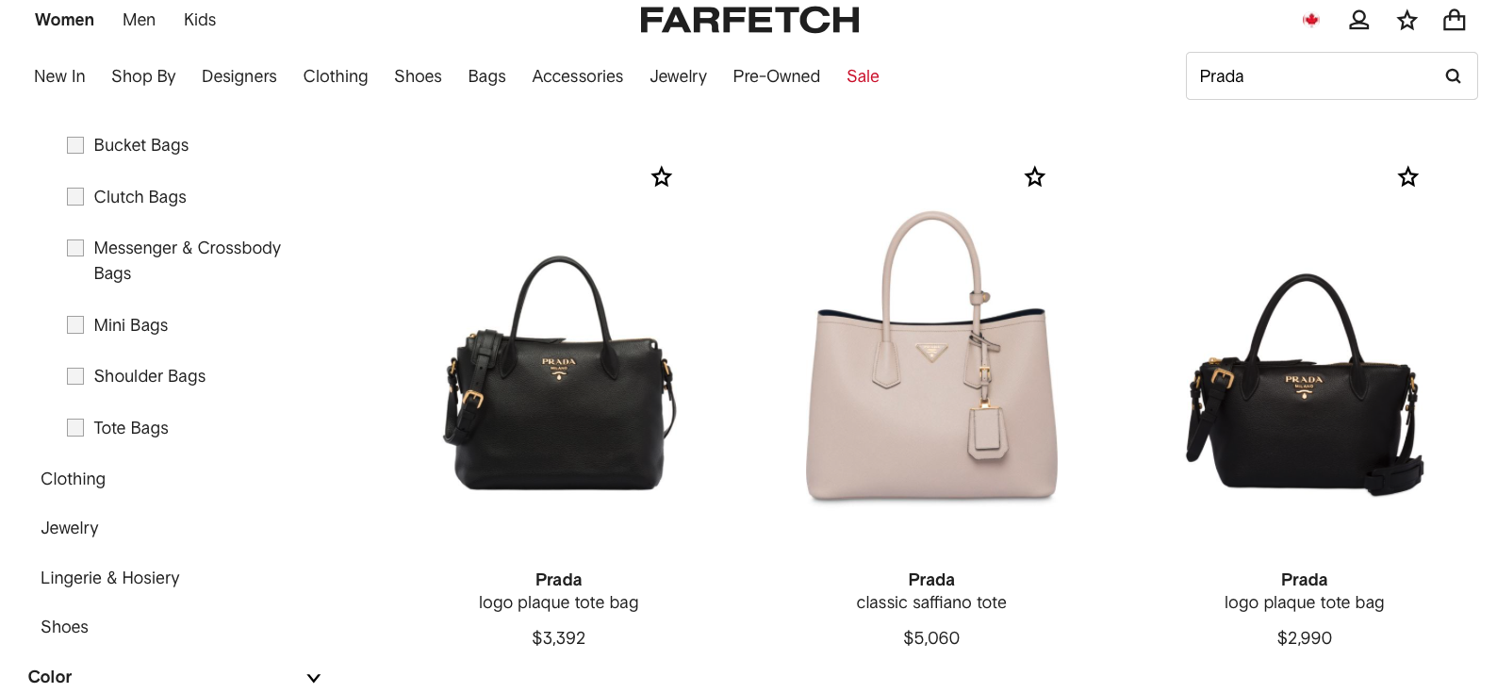
Prada

Slide 10
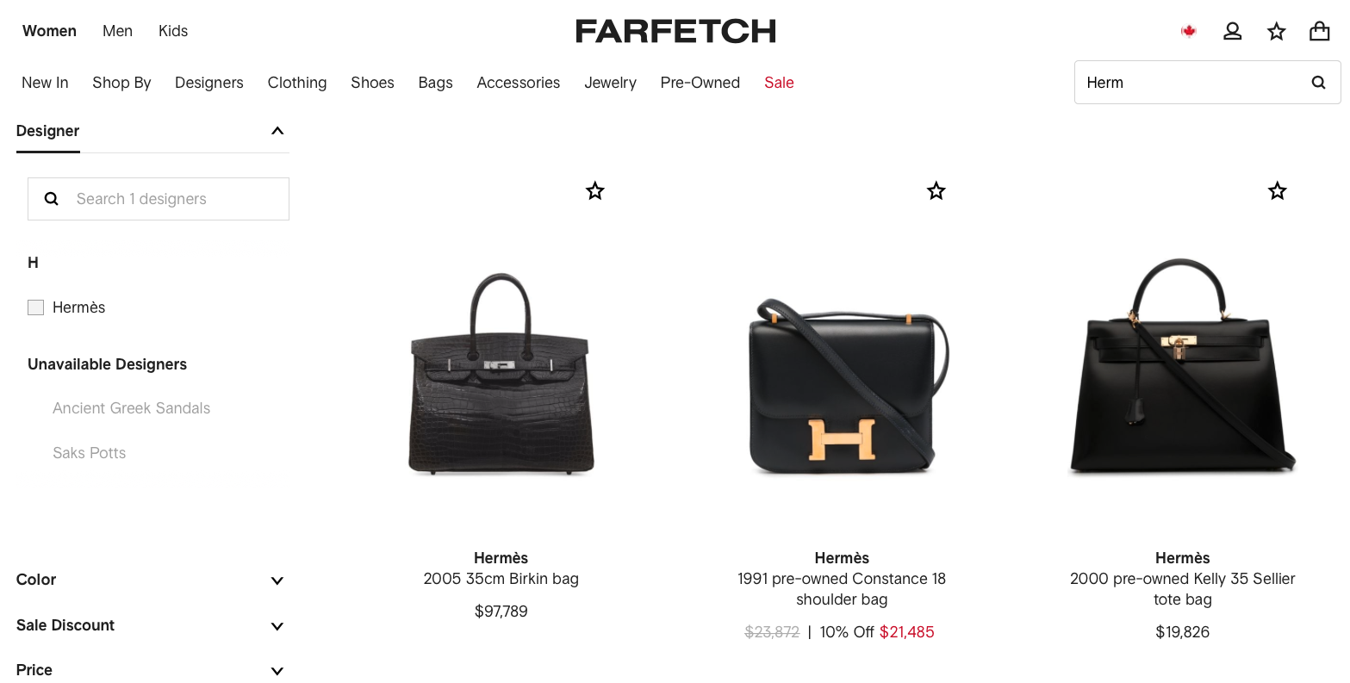
Hermès

Slide 11
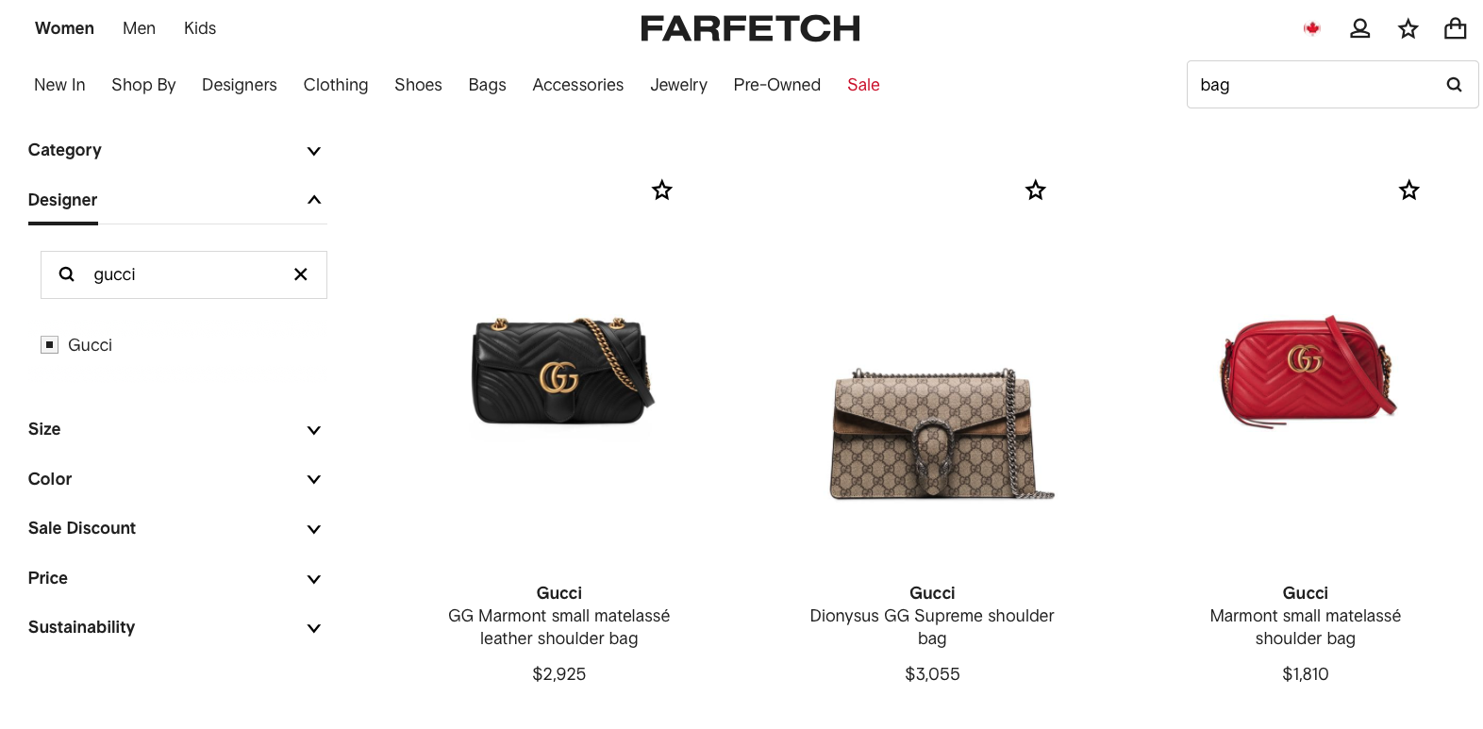
Gucci

Slide 12
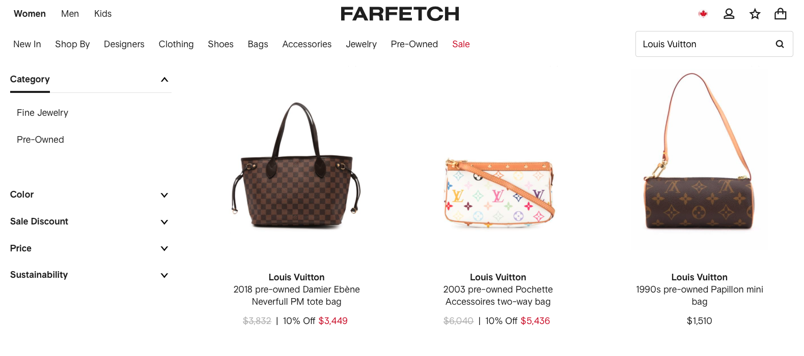
Louis Vuitton

Slide 13
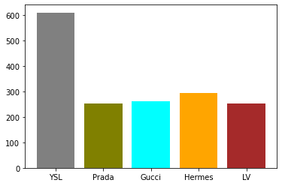
5 Brands Distribution
Class imbalance

Slide 14
Approach

Slide 15
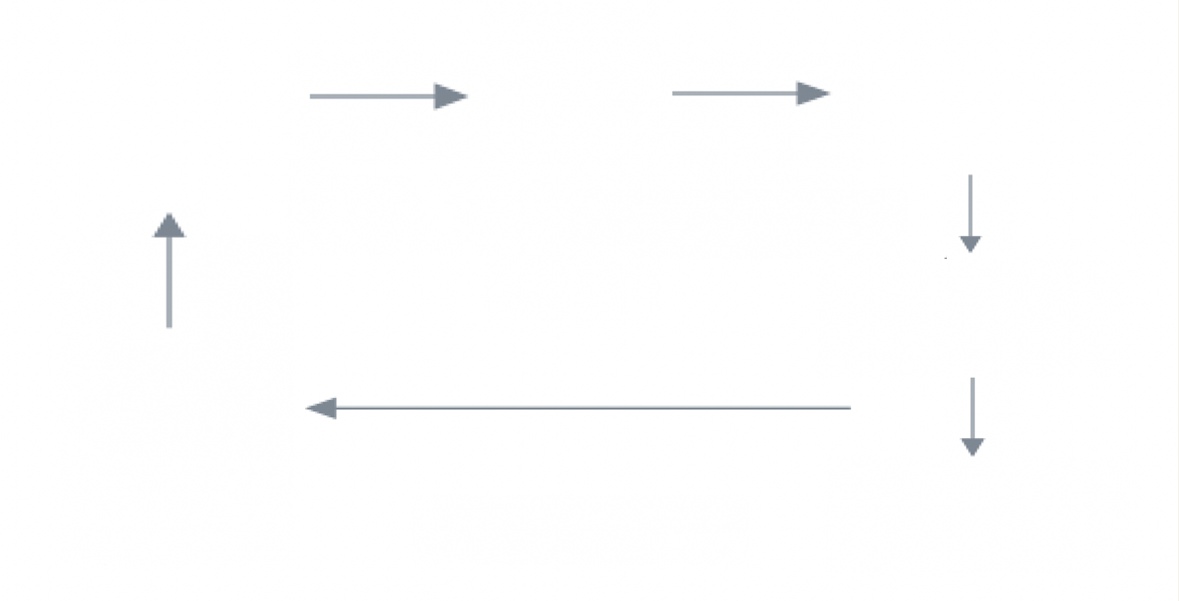


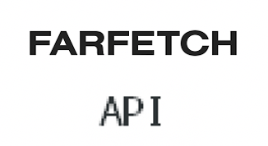



Tools & Workflow
Bi-weekly update
Quarterly re-train model

Slide 16
Model Training
FREEZE BASE LAYERS
OUTPUT
Convolutional layers
untrainable during
gradient descent process
1 dense layer
5 classes
Softmax Activation
TRANSFER LEARNING
INPUT
Input shape = 150, 150, 3 Base = VGG16
Flatten
Added 3 dense layers ReLu Activation
VGG16
exclude the top layers

Slide 17
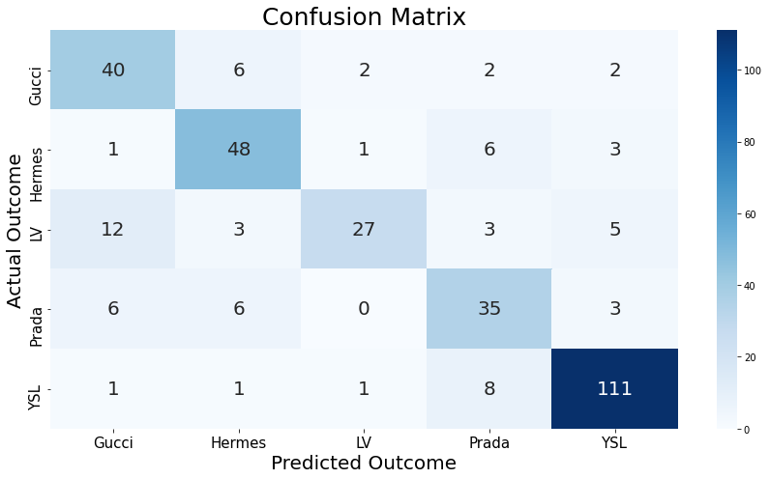
Model Result
Accuracy 78%

Slide 18
Deployment

Slide 19

App Demo Predicted Correctly

Slide 20

App Demo Predicted Incorrectly

Slide 21
Future WORK

Slide 22
Future Work
Improve
Bag Sections
Detect Logos
Expand
Product Lines
add more data and close-up images
cv2
Sneakers
detect knockoff and authentic products
Watches
Object Detection
YOLO
Increase accuracy

Slide 23
THANK YOU
SYNYC

Slide 24
APPENDIX

Slide 25
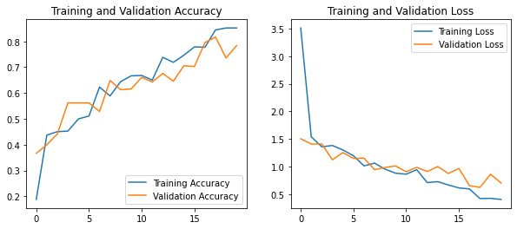
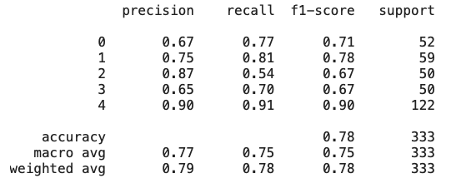
model predict outcome

Slide 26
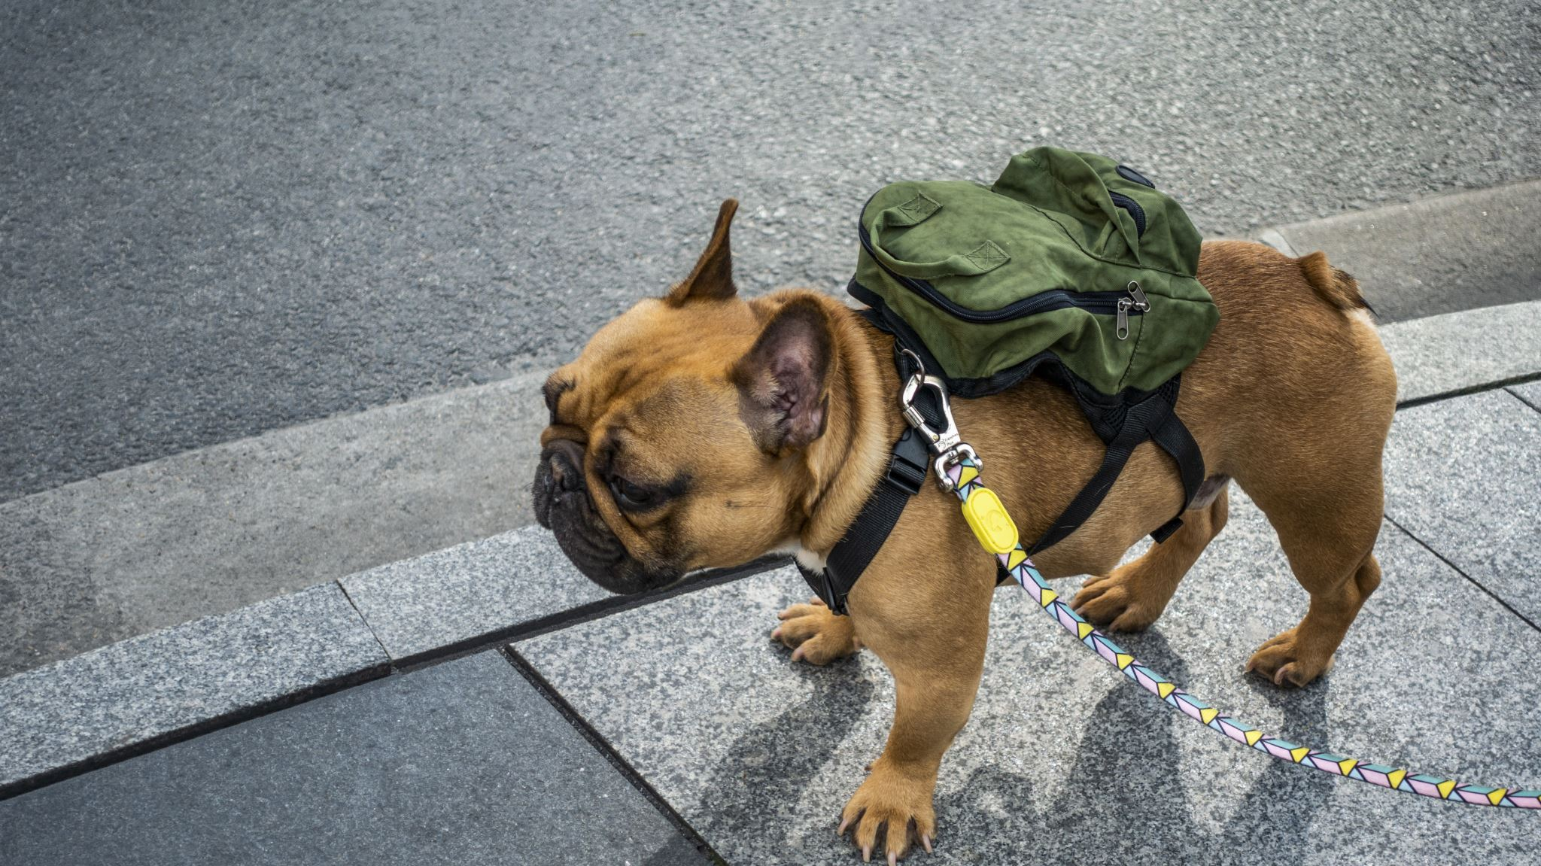
bag hunter
Farfetch.com
Deep Learning Bags Brand Prediction App

